Slide 1
A Music Sequencer Application
Adam Lloyd Simons

Slide 2
Aims
To create an application to accompany a musician. The application must be able create backing tracks and to record and playback audio. This application should demonstrate computing techniques that are relevant to the product.

Slide 3
Objectives
The project must demonstrate an understanding of computer music and what musicians currently use
The project must be designed with the research in mind to create an easy to use interface that requires little to no learning curve
The project must be created with for the needs of a musician and that for of someone who is not. This will be achieved by having an implementation of which both users can make use of
The project must adapt current music techniques used by musicians obtained from research
The program must demo some sort of concurrency running within
The project must include an evaluation report

Slide 4
Possible Objectives
The program can be used on different operating systems
The editing of tracks such as splitting and deleting sections
The exportation of tracks to the user system
Notes:
Talk about the deliverables

Slide 5
Research
What is computer music?
Competing Products
Programming Languages
Concurrency Techniques

Slide 6
What is computer music?
Collins(2010) “any music that involves a computer at any stage of its life cycle.”
Can be split into 2 areas
Digital Audio Recording
MIDI Recording

Slide 7
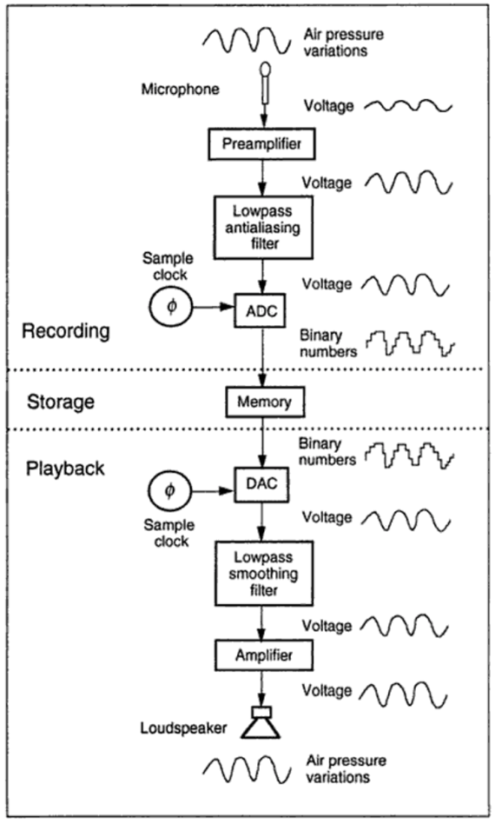
Roads, 1996, p. 23

Slide 8
MIDI
The MIDI file is the director and the recording is the script which is telling the synthesiser (e.g. a piano), the actor, how to play it. Glynn(2016)
Requires less memory to store than raw audio

Slide 9
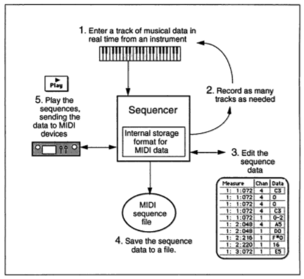
Competing Products
DAWs
GarageBand
Audacity
Roads, 1996, p. 662
Notes:
GB was released in 2004
Only available on OSX
As of 16th November 2017, Audacity has had over 46 million downloads

Slide 10
Design
Front end
Good UI techniques
Back end
Library research
Notes:
Talk about specialised languages. Csound, SuperCollider Concurrency Techniques, Threads, Threadpool

Slide 11
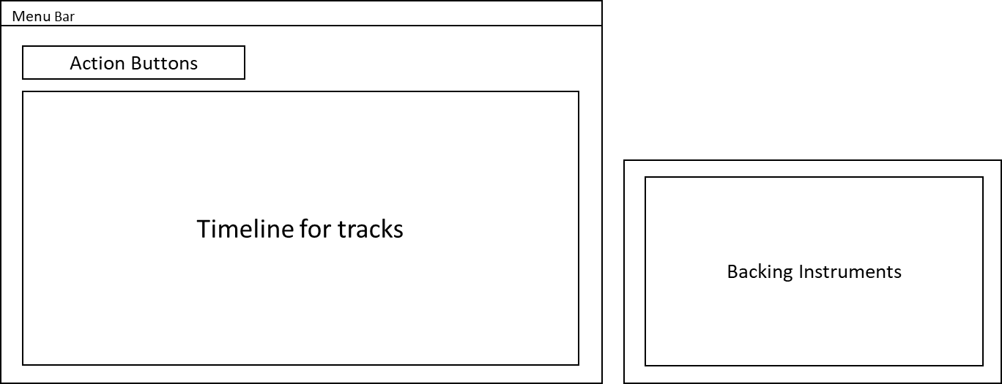
Wireframes & Pseudocode
Notes:
Ben Shneiderman then Jakob Nielsen and Rolf Molich
Visibility of system status
Match between system and the real world
User control and freedom
Consistency and standards
Error prevention
Recognition rather than recall
Flexibility and efficiency of use
Aesthetic and minimalist design
Help users recognise, diagnose and recover from errors
Help and documentation
(Wong, 2018)

Slide 12
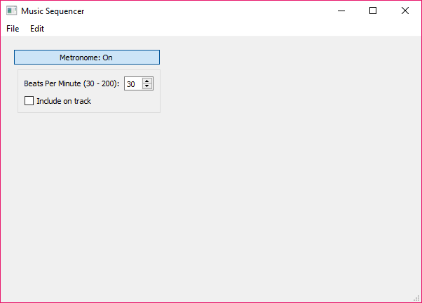
Early Development

Slide 13
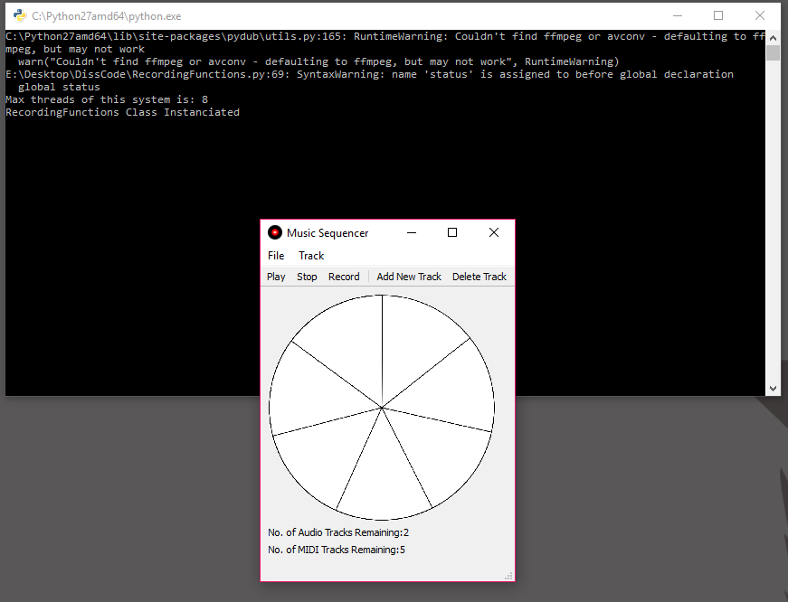
Final Implementation

Slide 14
Conclusion
All objectives are satisfied

Slide 15
References
Collins, N., 2010. Introduction to Computer Music. 1st ed. Hoboken: John Wiley & Sons.
Glynn, L., 2016. MIDI vs Digital Audio Recording – Which Is Right For You?. [Online] Available at: https://www.dawsons.co.uk/blog/midi-vs-audio-recording [Accessed 22 November 2017].
Roads, C., 1996. The Computer Music Tutorial. 1st ed. Cambridge: MIT Press.

Slide 16
Demos of code

